Slide 1


Notes:
InaSAFE is free software that produces realistic natural hazard impact scenarios for better planning, preparedness and response activities. It provides a simple but rigorous way to combine data from scientists, local governments and communities to provide insights into the likely impacts of future disaster events.

Slide 2


Thanks to my sponsors for this talk

Slide 3




Who am I?
Tim Sutton tim@kartoza.com
InaSAFE developer team lead www.inasafe.org
QGIS Project Steering Committee member and long-time developer (since 2002)
qgis.org
Kartoza director
and Open Source geek kartoza.com

Slide 4
InaSAFE Key Concepts

Slide 5


Notes:
InaSAFE is free software that produces realistic natural hazard impact scenarios for better planning, preparedness and response activities. It provides a simple but rigorous way to combine data from scientists, local governments and communities to provide insights into the likely impacts of future disaster events.

Slide 6

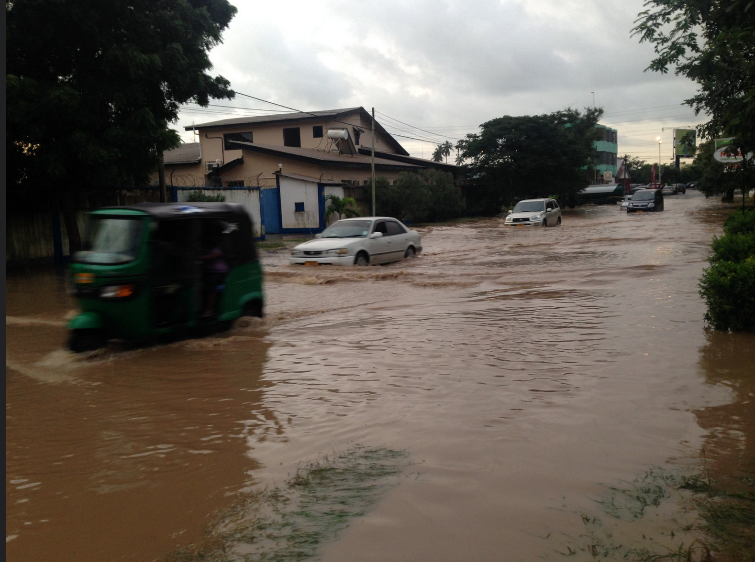

Slide 7
Acquiring flood data using remote sensing
Summary
Single event usage? | Yes - each dataset is typically for a single event
Multi event usage? | Yes, by combining flood areas from two or more events
Accuracy | Can be very good
Pros | Can cover large areas
Cons | May not work due to cloud cover, can be expensive to circumvent this.

Slide 8
Acquiring flood data using local knowledge
Summary
Single event usage? | Yes
Multi event usage? | Yes, local knowledge typically will span multiple events
Accuracy | Typically only accurate to subward level
Pros | Fairly quick to create the data, does not require sophisticated technology
Cons | Susceptible to human error and coarse accuracy

Slide 9

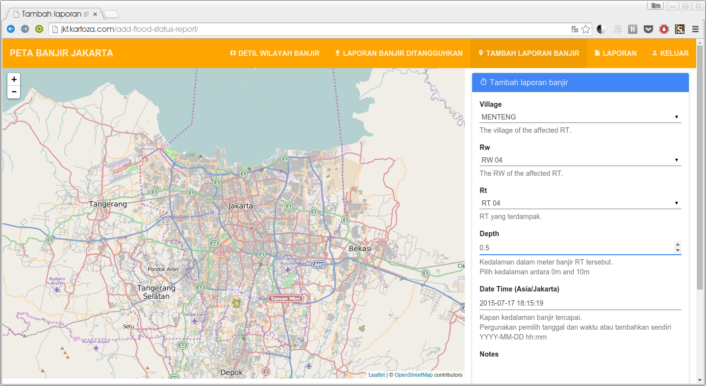

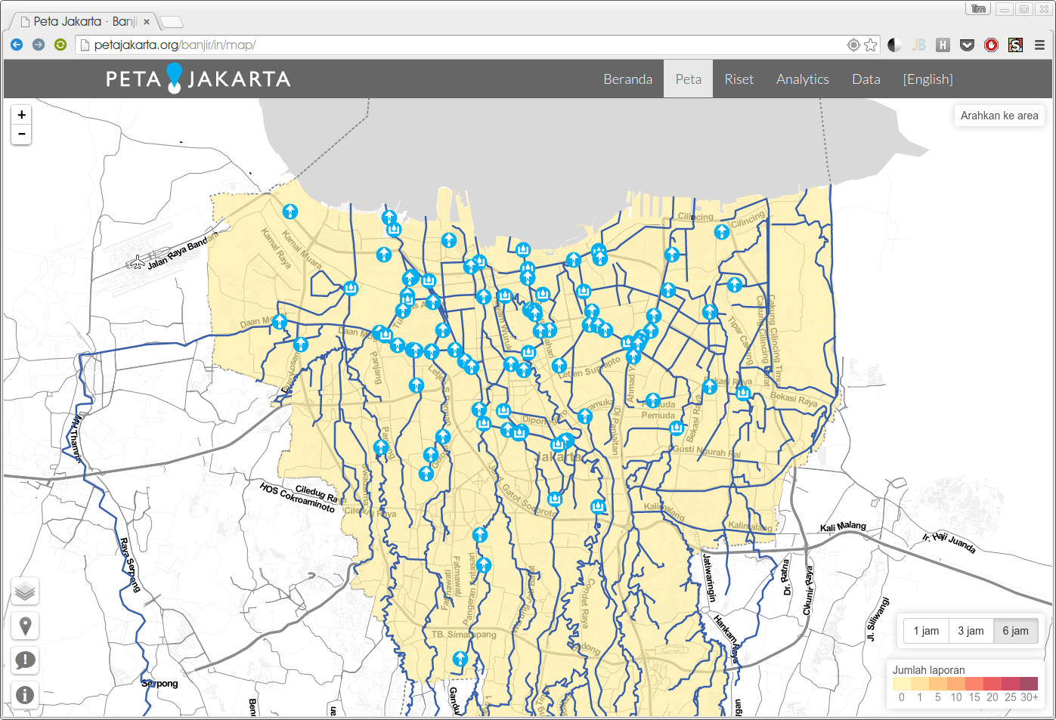
Acquiring flood data using local knowledge

Slide 10
Acquiring flood data using modelling techniques
Summary
Single event usage? | Yes
Multi event usage? | Yes
Accuracy | Accuracy may be very variable depending on the datasets used the the algorithms employed.
Pros | Does not require large amounts of human input, may provide insight into the impact of extraordinary events such as 100 year floods.
Cons | A large number of techniques available make it difficult to choose an appropriate one. Algorithm parameters need to be carefully tuned and a high confidence in the input data used for modelling is needed.

Slide 11
Data format requirements for flood data in InaSAFE
Key notes for floods
Format | Vector polygon data or raster data
Required fields | Applies to vector flood data only: A field representing whether the polygon is flood prone or not. We recommend calling this field ‘FLOODPRONE’ and using a value of ‘YES’ to indicate that it is flood prone.
Notes | InaSAFE does not need ‘engineering quality’ data. When provided in raster format, each cell value will typically represent a flood depth in meters.
Sourcing | Can be sourced from community mapping efforts, from your national mapping agency.

Slide 12



Slide 13


Data format requirements for population data in InaSAFE
Key notes for population data
Format | Raster ‘cell’ data
Requirements | Currently the data should be in EPSG:4326 CRS
Notes | Be sure you know whether you are dealing with density or count data.
Sourcing | WorldPop or from national government datasets.

Slide 14


Data format requirements for roads data in InaSAFE
Key notes for roads
Format | Vector line data
Required fields | A field representing road type
Notes | Topologically correct data is ideal - that is road intersections should converge properly
Sourcing | Can be sourced from community mapping efforts in OSM (using the built in tool in InaSAFE makes this easy) or from national government datasets.

Slide 15


Data format requirements for buildings data in InaSAFE
Key notes for buildings
Format | Vector polygon data
Required fields | A field representing building type
Notes | InaSAFE does not need ‘engineering quality’ data.
Sourcing | Can be sourced from community mapping efforts in OSM (using the built in tool in InaSAFE makes this easy) or from national / local government datasets.

Slide 16

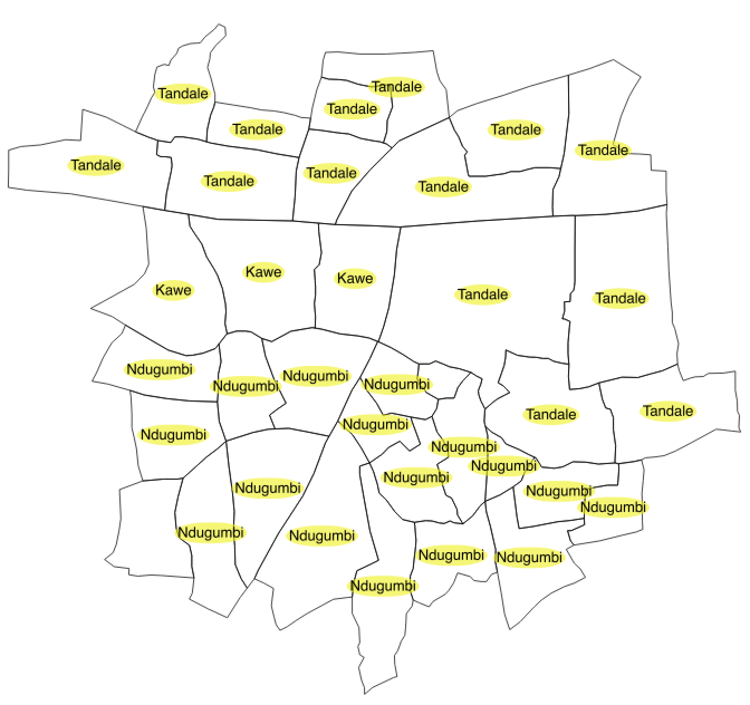
Aggregation

Slide 17

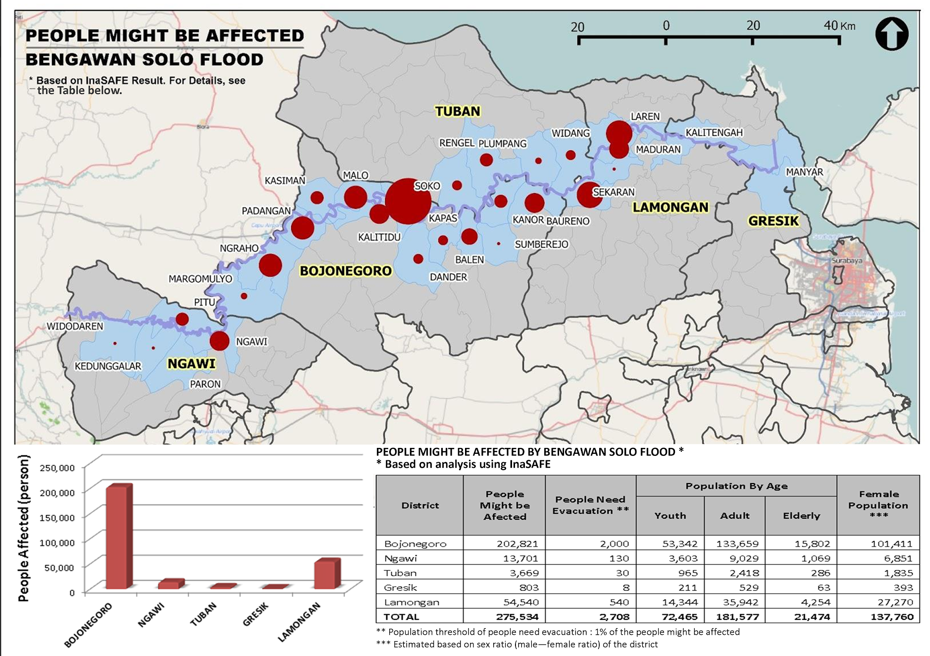

Slide 18

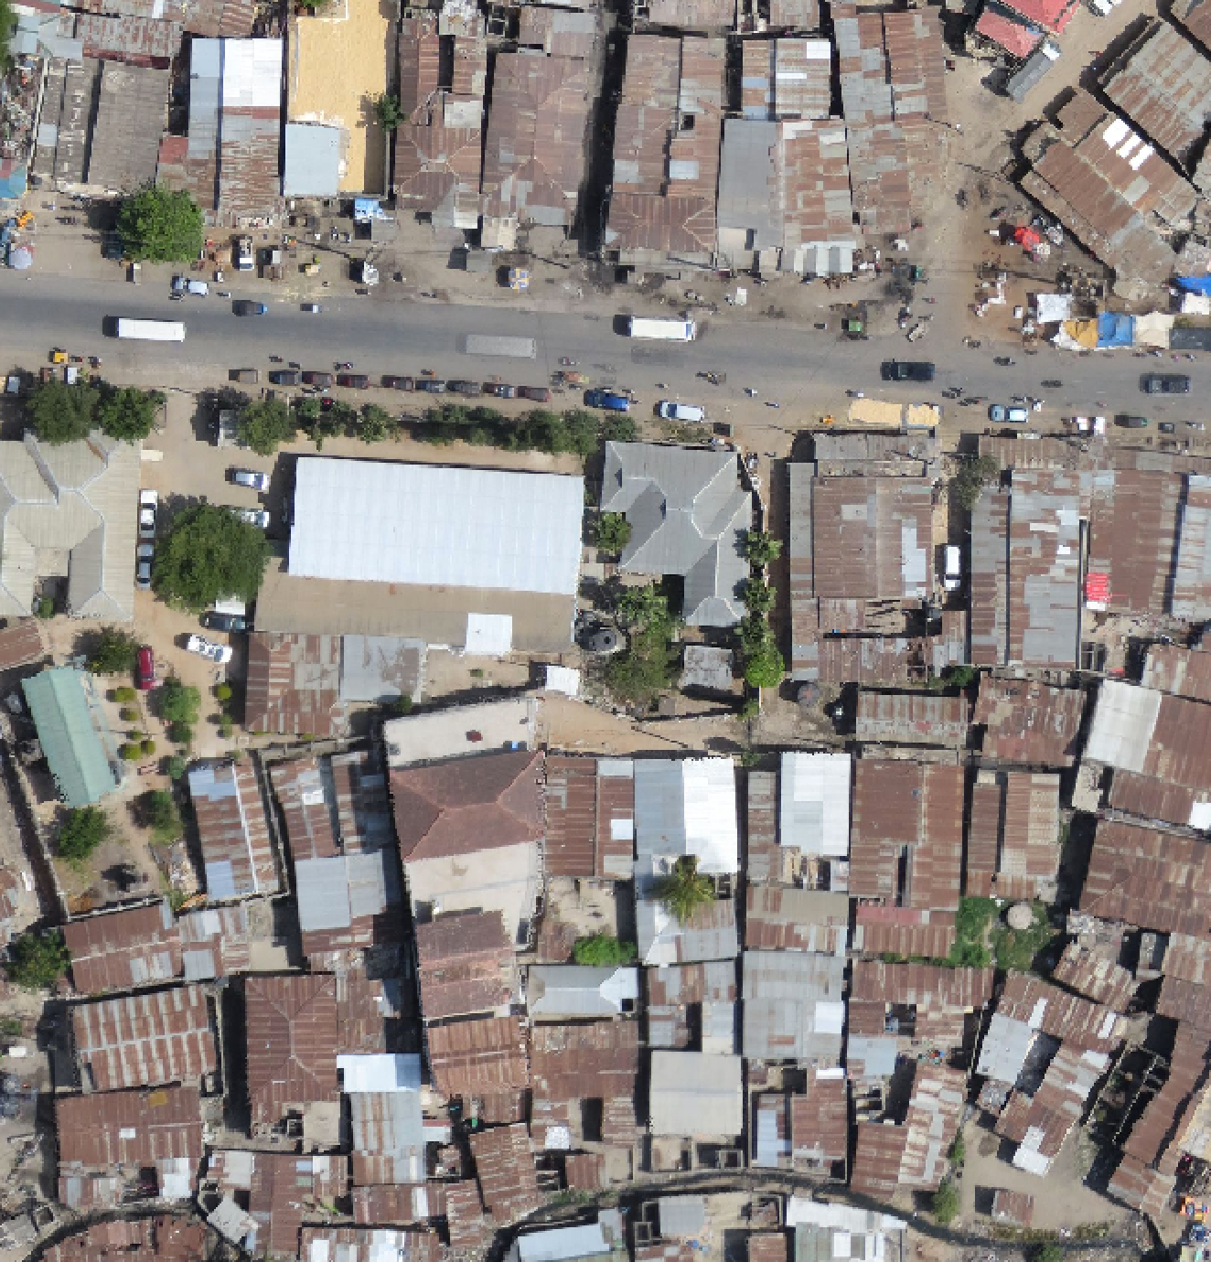
Contextual Data

Slide 19


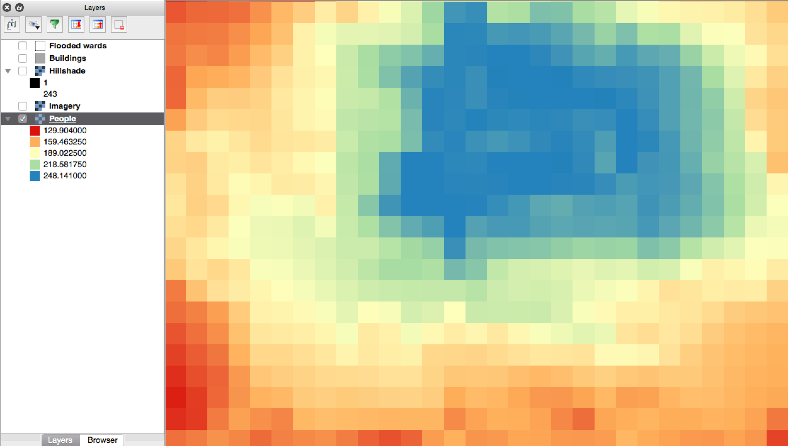
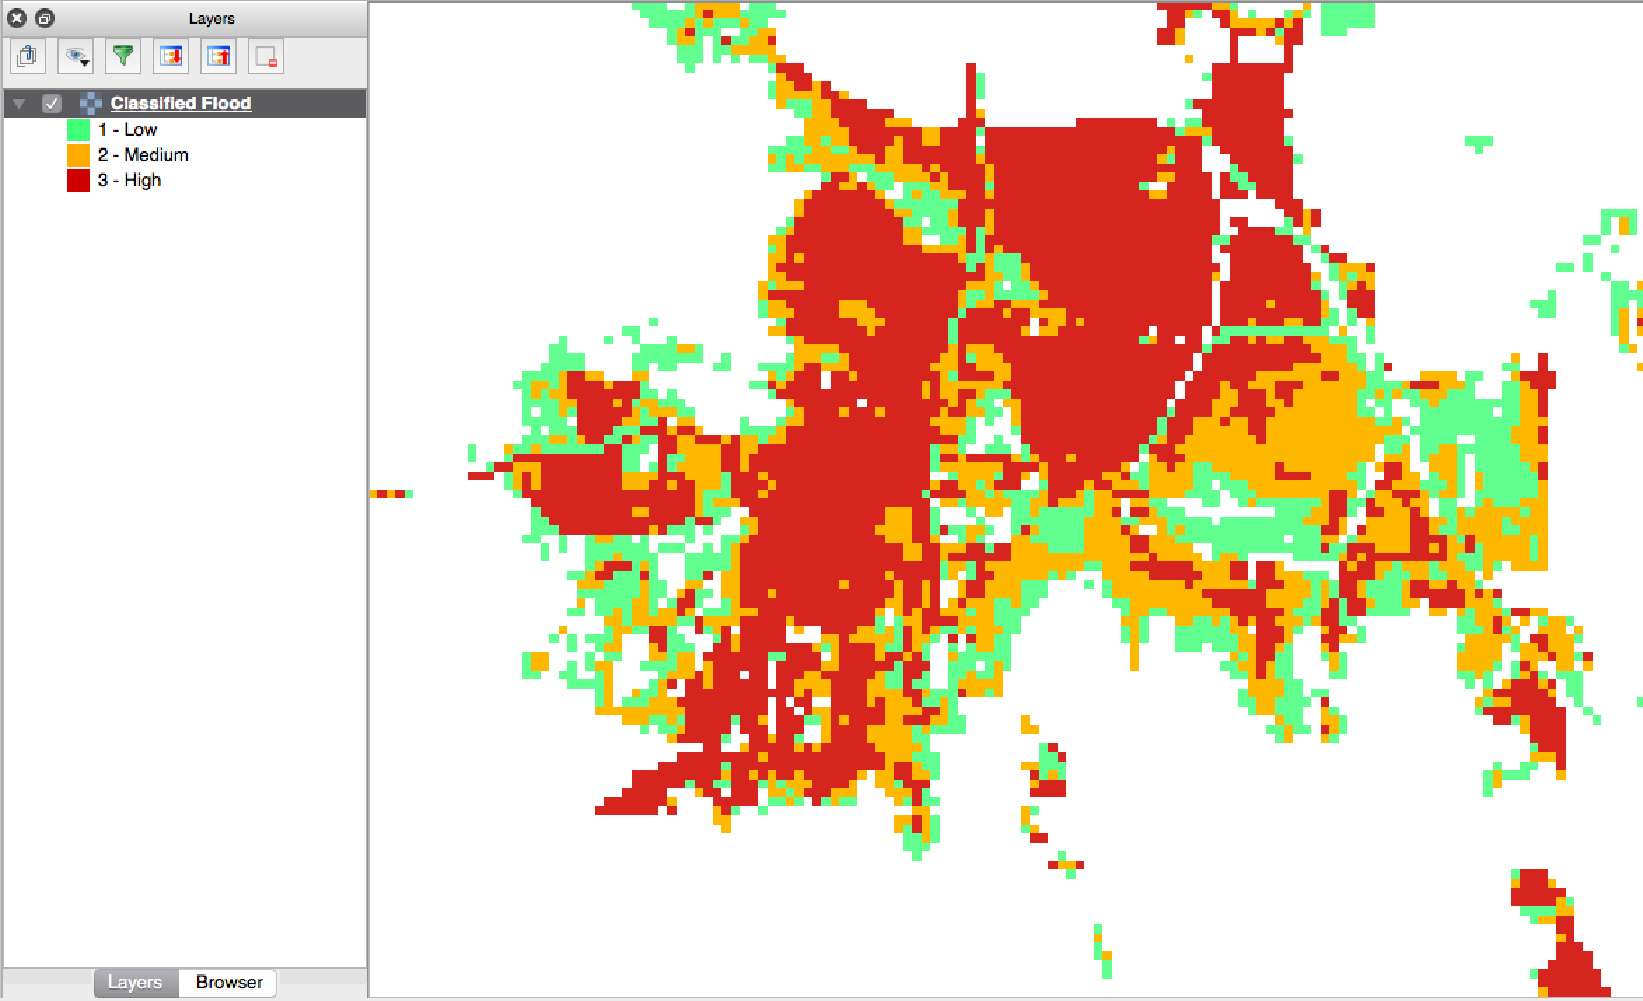
Continuous vs Classified data

Slide 20

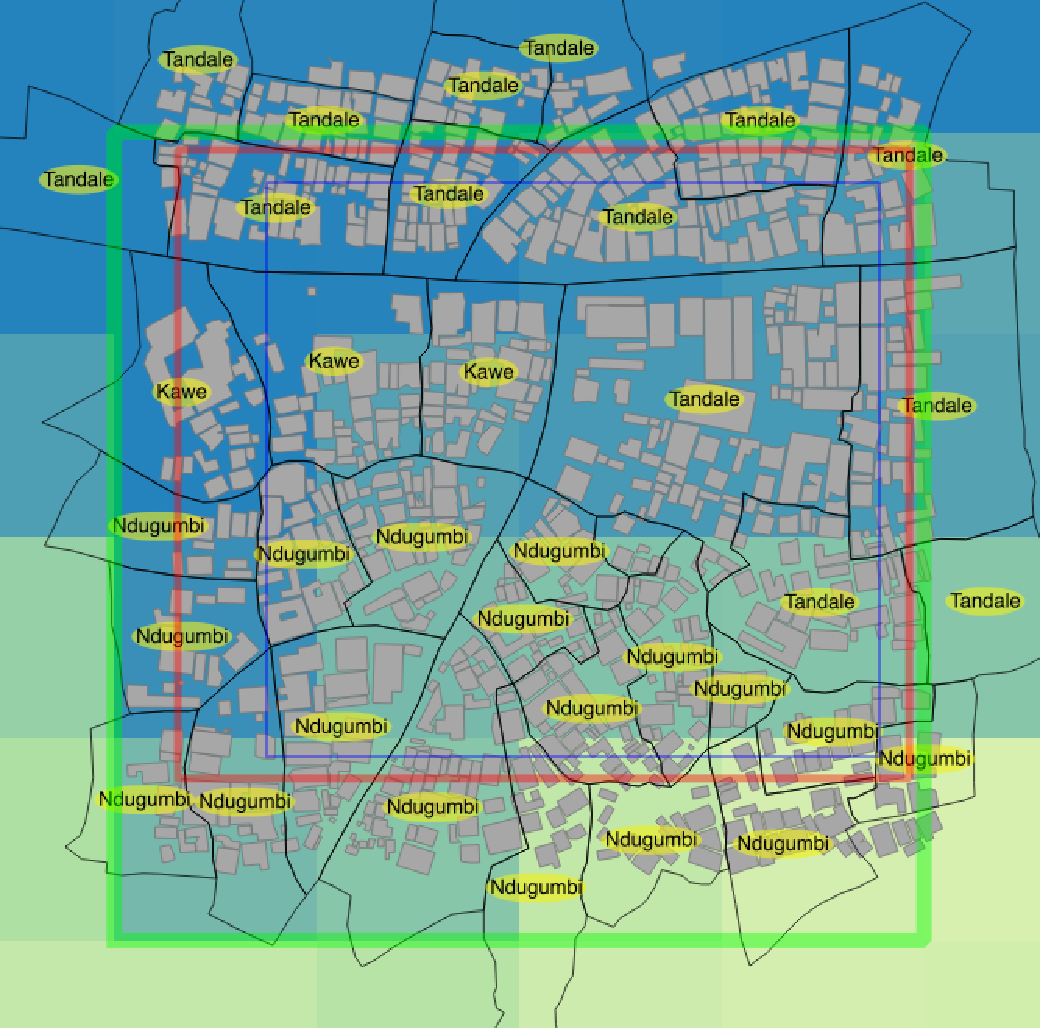
Analysis Extents

Slide 21

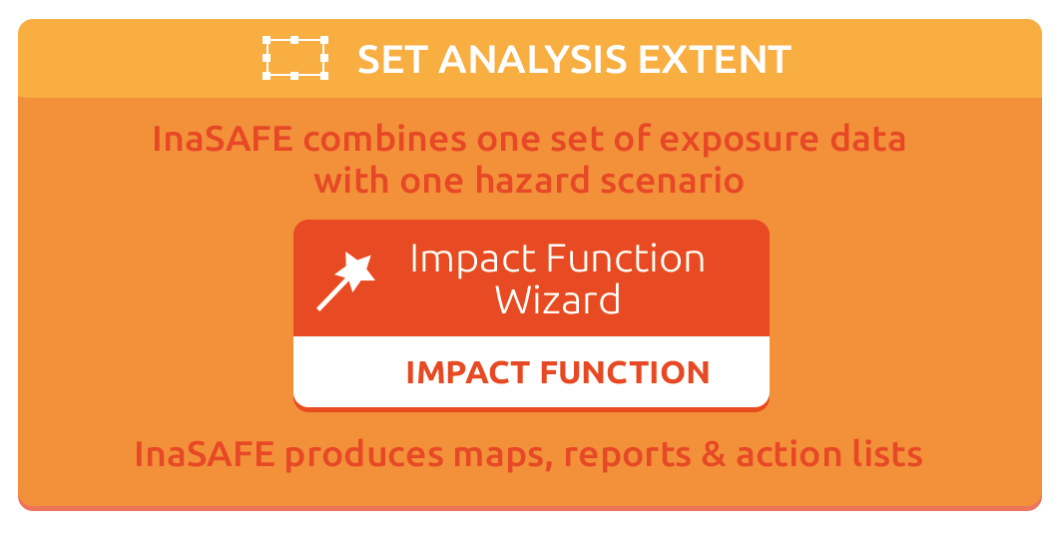
Impact Function

Slide 22


Earthquake
Hazard Type | Supported Hazard Layers | Supported Exposure Layers
Earthquake | Raster | Continuous raster population count Classified polygon vector buildings Classified point vector building centroids

Slide 23
Generic
Hazard Type | Supported Hazard Layers | Supported Exposure Layers
Generic | Classified polygon | Continuous raster population count Classified polygon vector buildings
 | Classified raster | Continuous raster population count Classified polygon vector buildings
 | Continuous raster | Continuous raster population count
?

Slide 24


Flood
Hazard Type | Supported Hazard Layers | Supported Exposure Layers
Inundation | Continuous raster | Continuous raster population count Classified polygon vector buildings Classified point vector building centroids Classified line vector roads
 | Classified polygon | Continuous raster population count Classified polygon vector buildings Classified point vector building centroids Classified line vector roads

Slide 25


Volcano
Hazard Type | Supported Hazard Layers | Supported Exposure Layers
Volcano | Classified point | Continuous raster population count Classified polygon vector buildings
 | Classified polygon | Continuous raster population count Classified polygon vector buildings

Slide 26


Impact Function Products

Slide 27

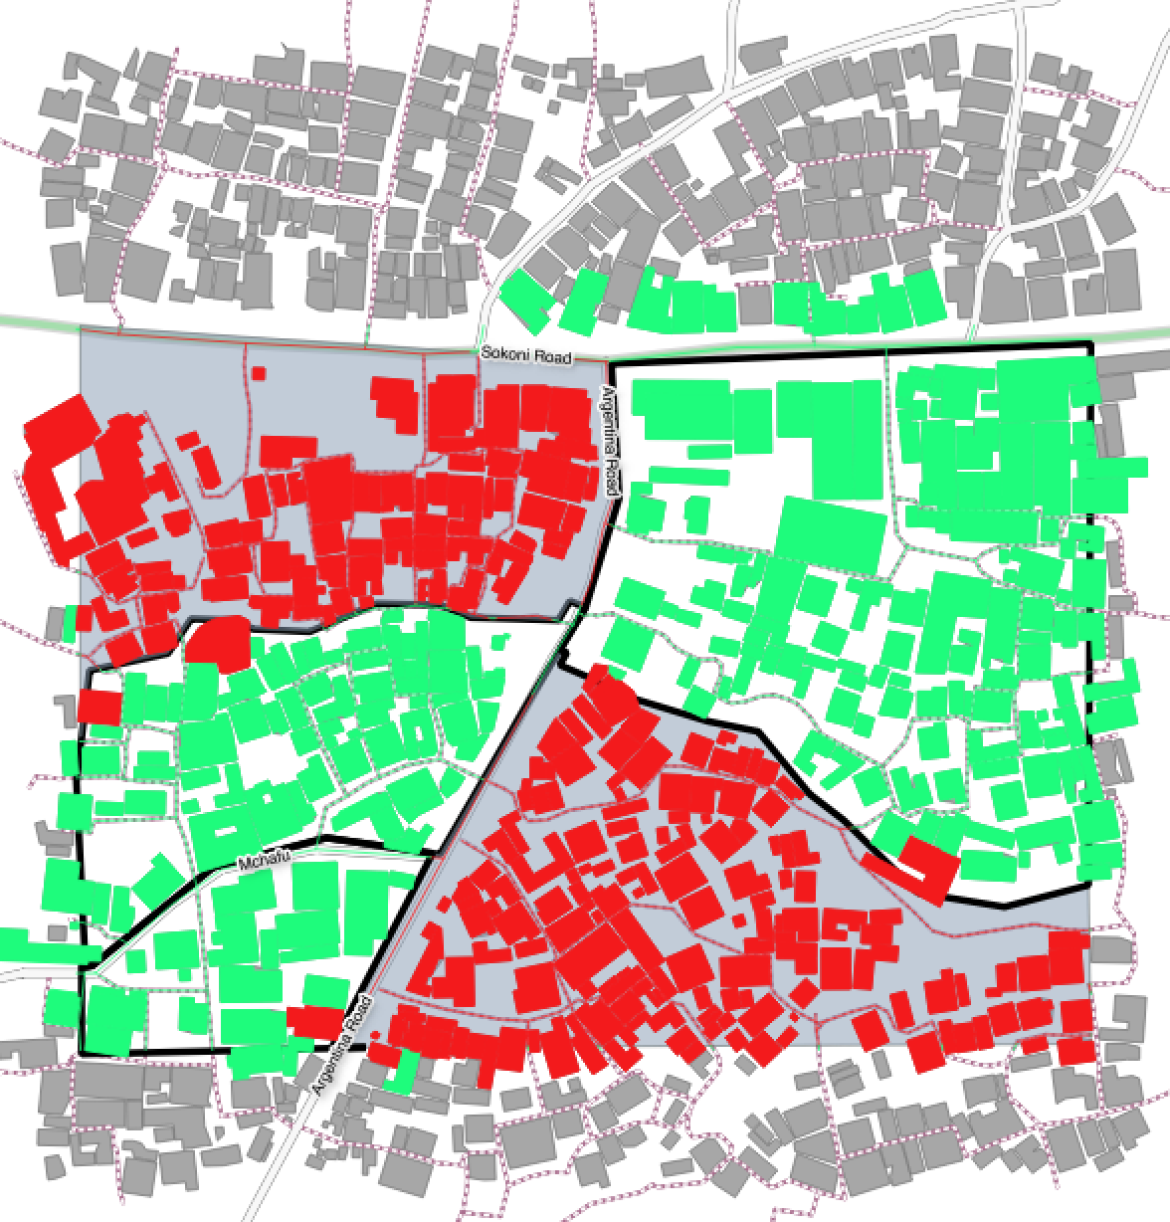
Impact Layer

Slide 28

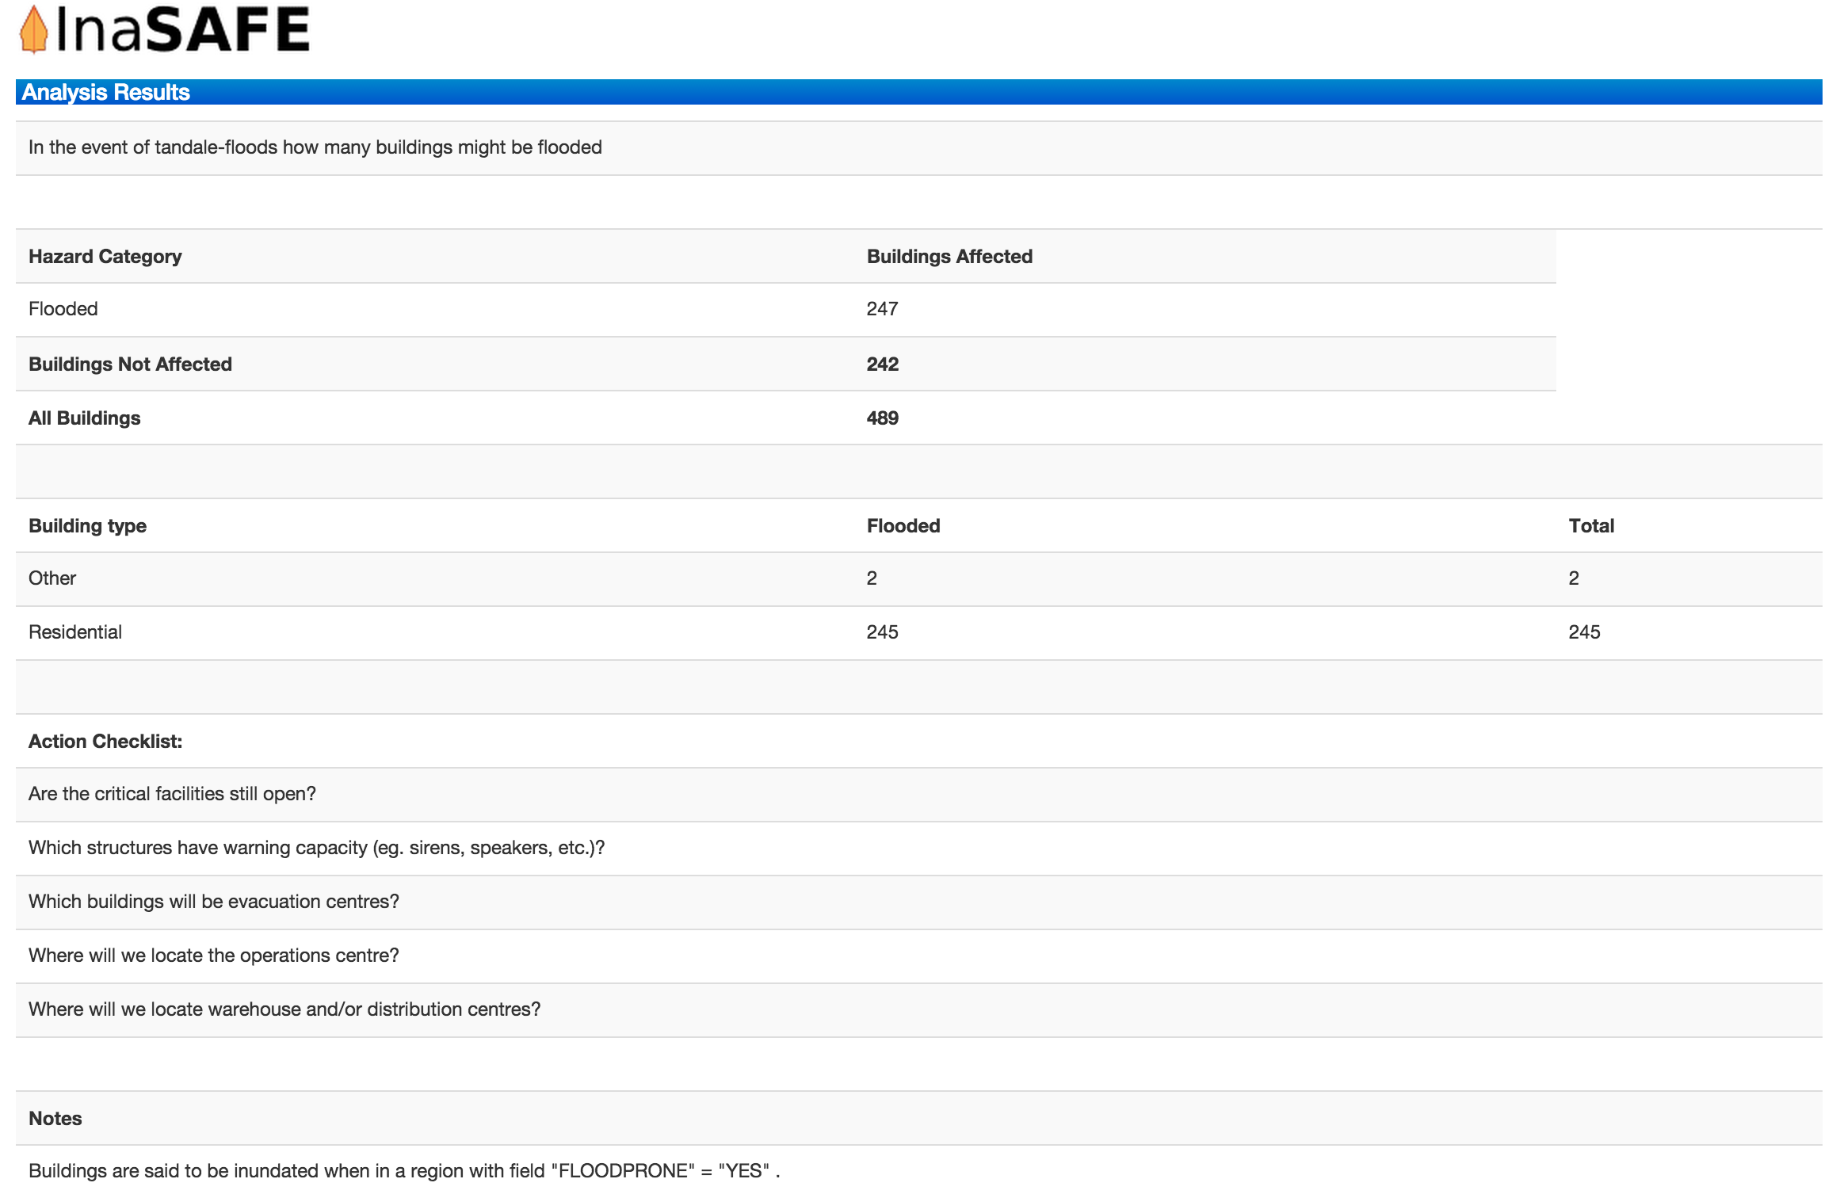
Impact Summary

Slide 29

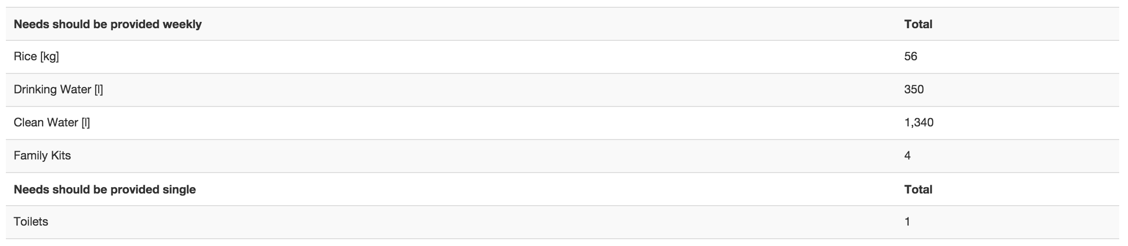
Minimum Needs

Slide 30

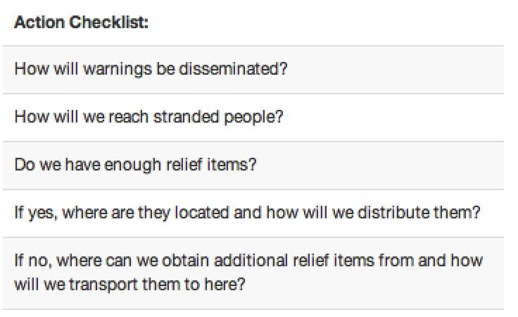
Action checklists

